Slide 1
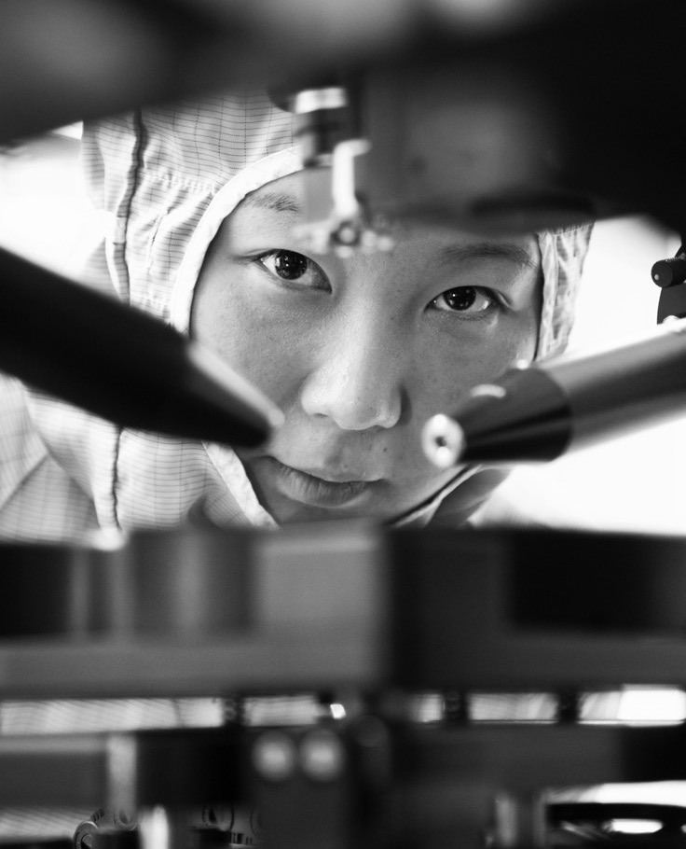



Optimal peptide quantification via machine learning enhanced fragment ion ranking in DIA-MS proteomics
LINA LU
SUPERVISOR: Lars Malmström CO-SUPERVISOR: Aaron Scott

Slide 2
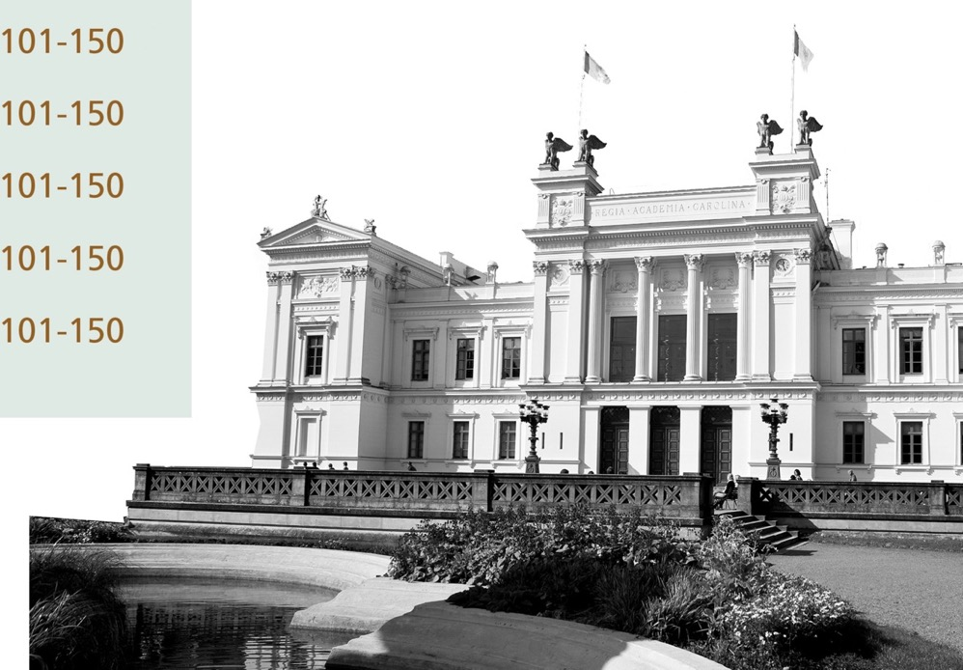
Overview
Introduction
Mass spectrometry Proteomics
Protocol
DIA data analysis
Machine learning
Algorithm
Goals
Materials and methods
Generalized workflow
Optimized workflow
Results
Conclusion

Slide 3

INTRODUCTION

Slide 4
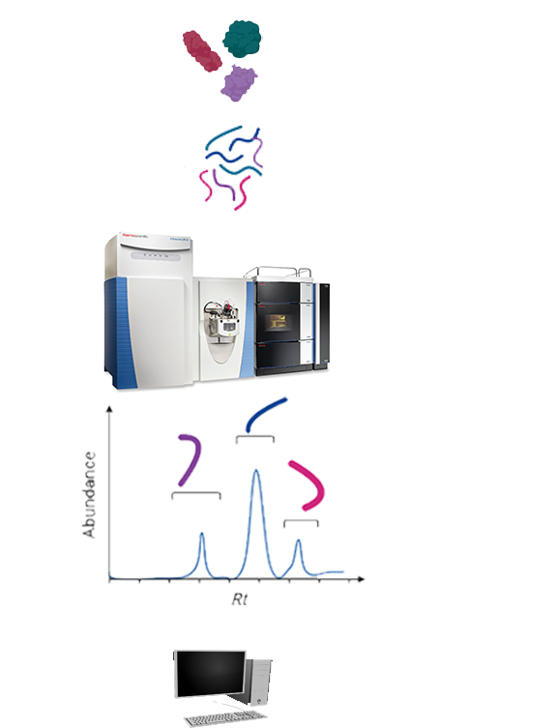
Mass spectrometry proteomics
Protein mixtures
Proteomics
Mass spectrometry proteomics
Liquid chromatography → Retention time (RT)
Mass spectrometer → mass spectrum (m/z etc.)
Data independent acquisition (DIA)
Digested peptides
LC-MS
✔ Complete mass spectral data
✔ Deeper data coverage
✔ Random identification is avoided
✔ Supportive of comparison cross samples
❌ More complicated data analysis process
Abundance
Data collected
RT
Data analysis

Slide 5
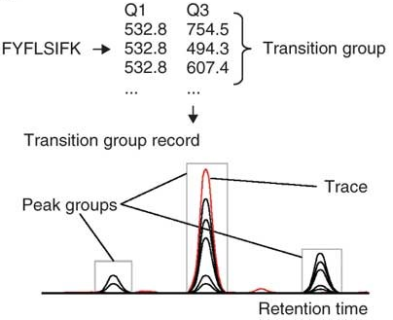
DIA data analysis
Chromatographic extraction
Search engines & Spectra library → PSMs
Calculation of peptide abundance
Sum
Differential expression
Normalization
Statistical analysis
Source: Reiter, L., Rinner, O., Picotti, P. et al. mProphet: automated data processing and statistical validation for large-scale SRM experiments. Nat Methods 8, 430–435 (2011). https://doi.org/10.1038/nmeth.1584

Slide 6
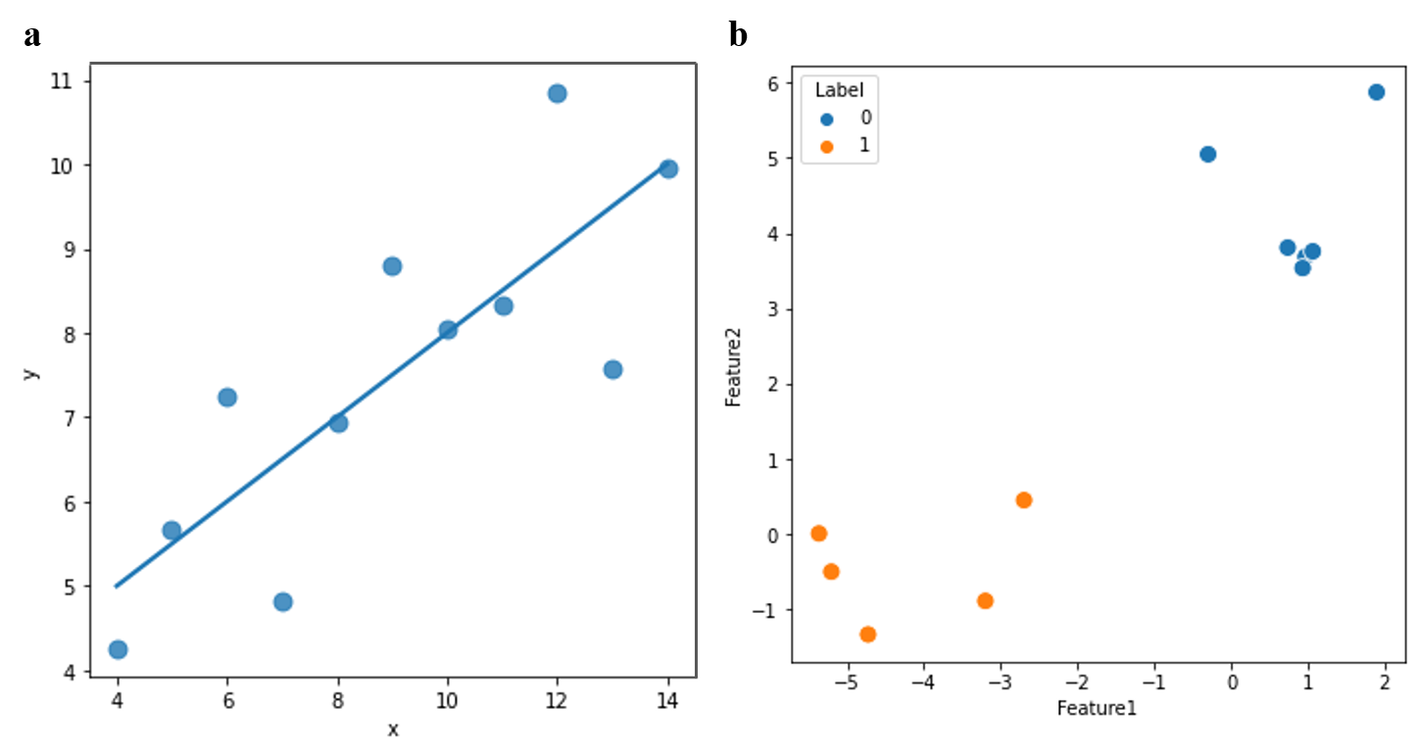
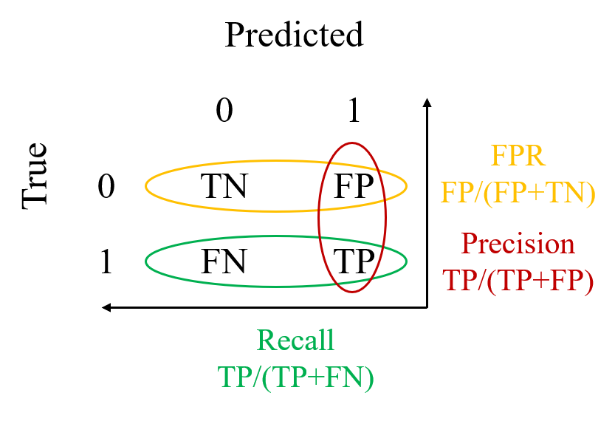
Machine learning: Target-decoy strategy
Data point | Features | True labels | Decision score | Predicted
Peakgroup 1 |  | 1 | 1.3 | 1
Peakgroup 2 |  | 1 | 0.5 | 0
Peakgroup 3 |  | 0 | 0.4 | 0
Peakgroup 4 |  | 0 | 1.2 | 1
Regression problems
Classification problems

Slide 7
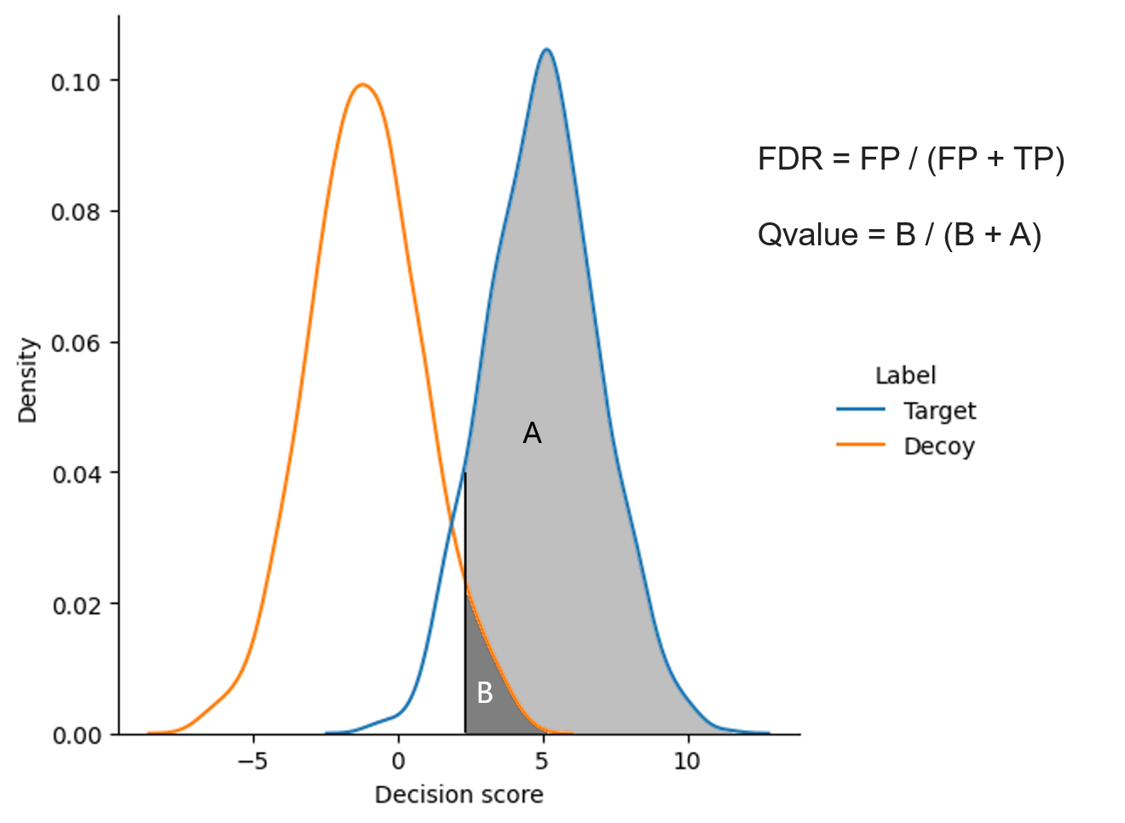
Algorithm: FDR control
Q values
False discovery rate (FDR) control
True peak groups
N fragment ions with strongest intensity (TopN)
Peptide quantification

Slide 8
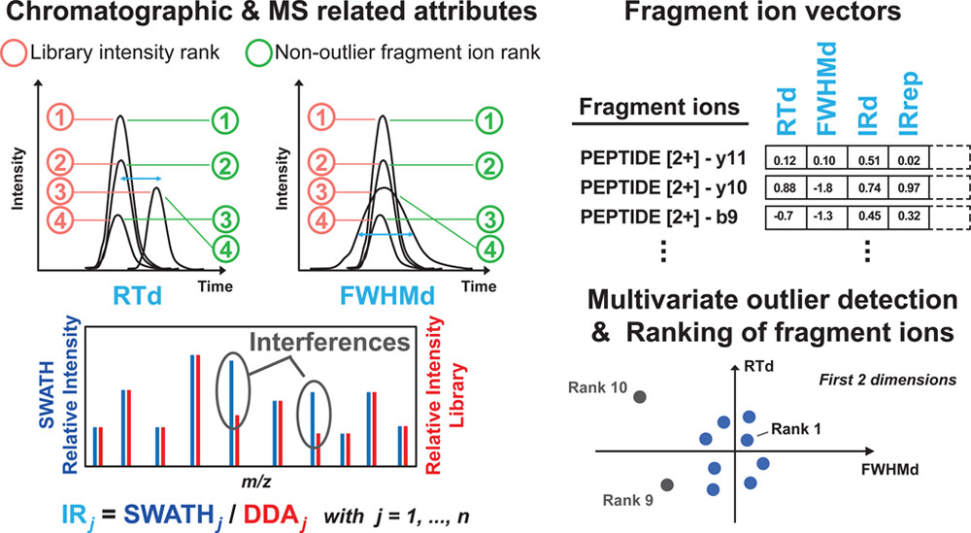
Problems: Fragment ion interferences
Intensity
A peakgroup
Retention Time deviation
SWATH Relative Intensity
Retention Time
Library Relative Intensity
Library intensity rank
Non-outlier fragment ion rank
1. A peak group may contain false fragment ions
2. Fragment ions with the strongest intensity might be the result of multiple peptides
Source: Aivett Bilbao, Ying Zhang, Emmanuel Varesio, Jeremy Luban, Caterina Strambio-De-Castillia, Frédérique Lisacek, and Gérard Hopfgartner Journal of Proteome Research 2015 14 (11), 4581-4593 DOI: 10.1021/acs.jproteome.5b00394

Slide 9

Goal of the thesis
Use machine learning to enhance fragment ion ranking for every peak group and use optimal methods to combine the fragment ion intensity to improve the accuracy of peptide quantification.

Slide 10

MATERIALS AND METHODS

Slide 11
Materials
Samples
Yeast spike-in benchmark data
Software
OpenSWATH / PyProphet / TRIC
Python
scikit-learn
gscore
Snakemake
Singularity container
NormalyzerDE
Groups | Yeast(μL) | iRT(μL) | Mouse Kidney(μL) | Yeast dilusion factor
1 | 1.5625 | 23.4375 | 25 | 8
2 | 0.390625 | 24.60938 | 25 | 32
Low fold change multi-species proteomics data [1]
Groups | Human | C. elegans | S. cereviviae | E. coli
1 | 1 | 1 | 1 | 1.3
2 | 1 | 1.1 | 1.2 | 1
[1] Bruderer R, Bernhardt OM, Gandhi T, Xuan Y, Sondermann J, Schmidt M, Gomez-Varela D, Reiter L. Optimization of Experimental Parameters in Data-Independent Mass Spectrometry Significantly Increases Depth and Reproducibility of Results. Mol Cell Proteomics. 2017 Dec;16(12):2296-2309. doi: 10.1074/mcp.RA117.000314. Epub 2017 Oct 25. PMID: 29070702; PMCID: PMC5724188.

Slide 12
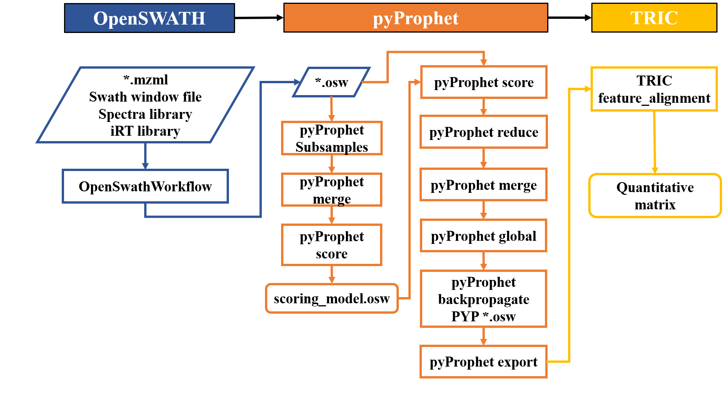
Generalized workflow

Slide 13
Model generation
Get training data
Model training
Features & labels
12 fragment ion sub-scores
Targets and decoys
Model
Logistic regression
Training methods
Hold-out cross-validation
Stochastic gradient descent (SGD)
Model improvements
Deal with noisy labels
OpenSWATH
Training data
*.osw
Training-test split
Merge osw tables
SGD
*.tsv
The reference classifier
Model improvements
Merged data
SGD
Data preprocessing
Models *.pkl
 | Target | Decoy
Total | 27 510 160 | 15 021 515
Initial training set | 22 009 046 | 12 016 294

Slide 14
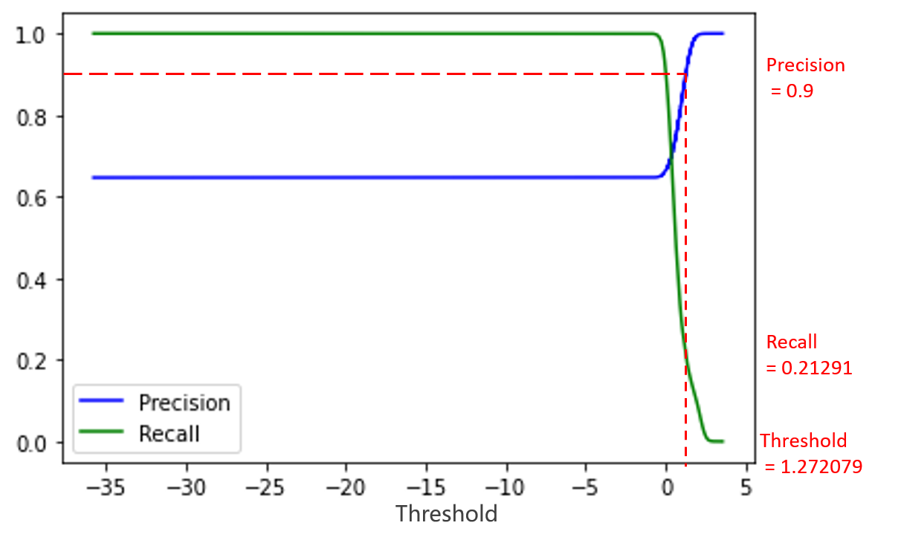
Model improvements: Precision/recall trade-off
Initial classifier
Decision scores
Precision > 0.9
Decision score threshold
New training set
Precision_90
SGD
 | Target | Decoy
initial | 22 009 046 | 12 016 294
precision_90 | 4 627 011 | 514 112
Decision score threshold

Slide 15
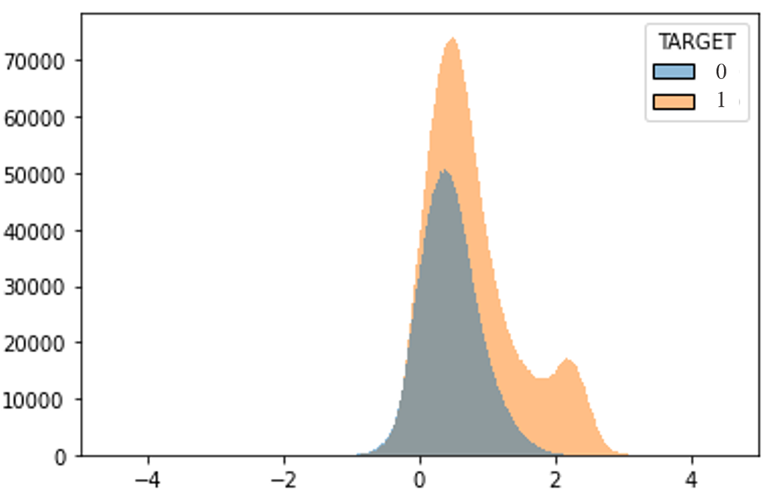
Model improvements: Qvalue cutoff
Initial classifier
Decision scores
Q values calculation
FDR control of training targets
New training set
qvalue_cutoff
Q value < 0.01
Counts
QValue = B / (B + A)
SGD
 | Target | Decoy
initial | 22 009 046 | 12 016 294
qvalue_cutoff | 2 699 272 | 12 016 294
A
B
Decision scores

Slide 16

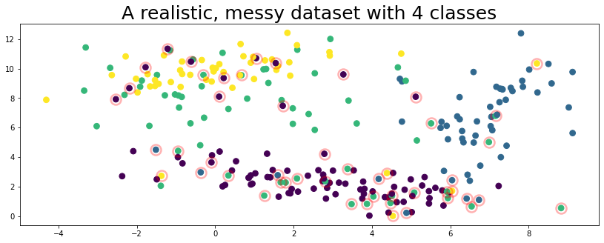
Model improvements: Confident learning
Implementation:
Module: Learn with noisy labels
Source: https://github.com/cleanlab/cleanlab
 | Target | Decoy
initial | 22 009 046 | 12 016 294
lnl | 22 009 046 | 12 016 294
Source: https://docs.cleanlab.ai/v2.0.0/tutorials/indepth_overview.html

Slide 17
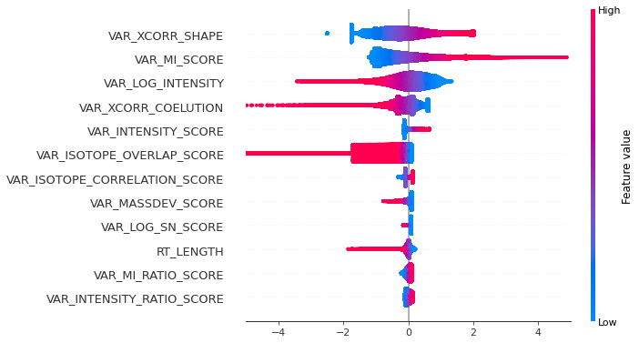
Generated models
Precision score of classifiers on the same test dataset
Features and Shapley values in qvalue_cutoff classifier
Classifiers | Precision score
initial | 0.662
precision_90 | 0.977
qvalue_cutoff | 0.980
lnl | 0.696
Features
SHAP value
Decoy target

Slide 18
Method application: Fragment ion ranking and FDR control
Generated classifiers
Raw data
Single run
Decision scores
Q values
FDR control
OpenSWATH
pyProphet
Data preprocessing
Prediction
Gscore package
Protein and peptide level
Fragment ion level

Slide 19
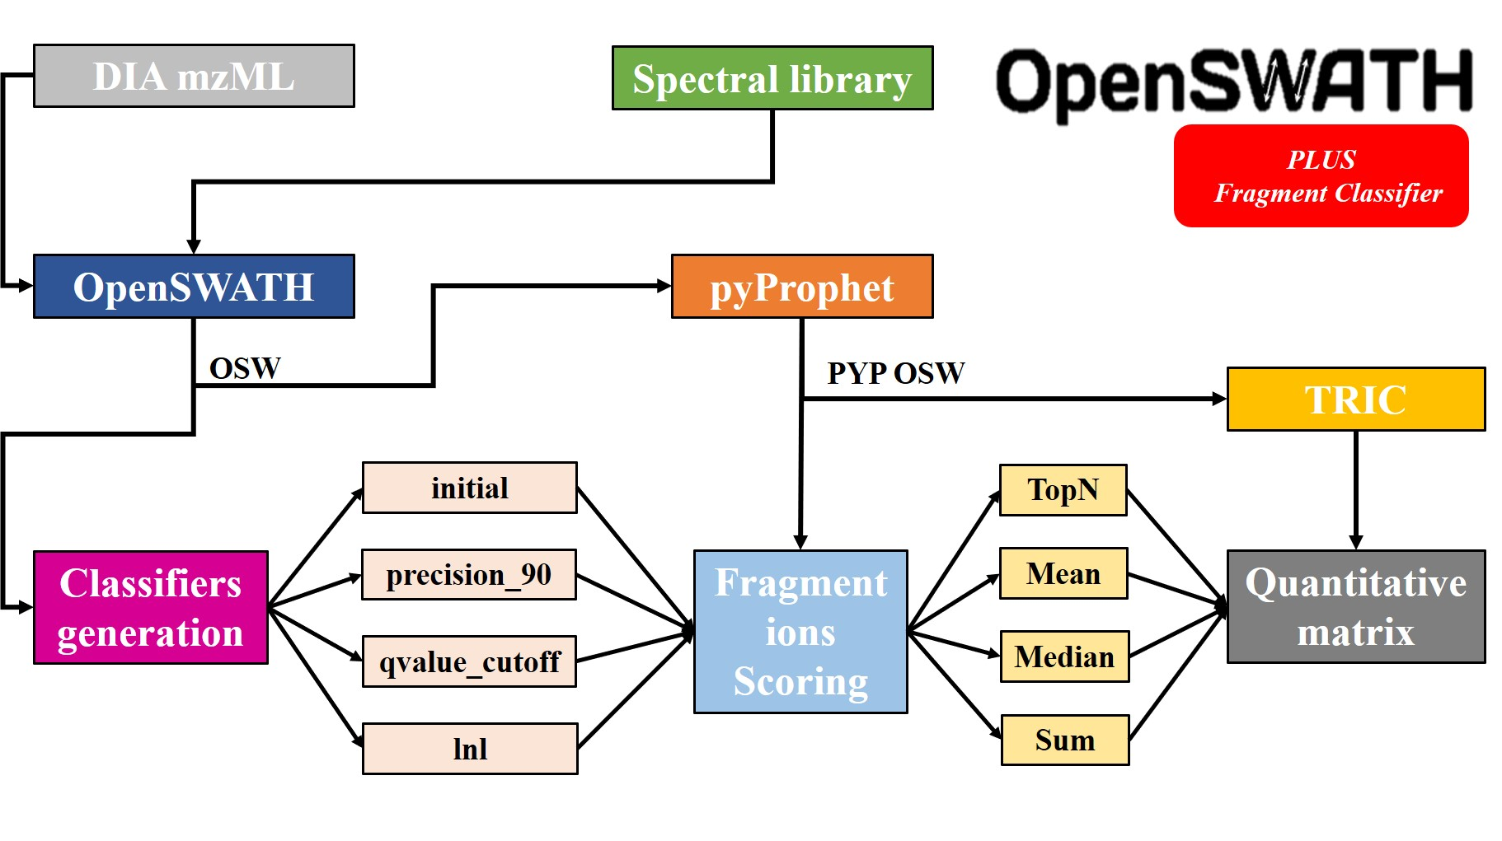
Method application: Precursor calculation methods
TopN
Mean
Median
Sum
Portable python package

Slide 20

RESULTS

Slide 21
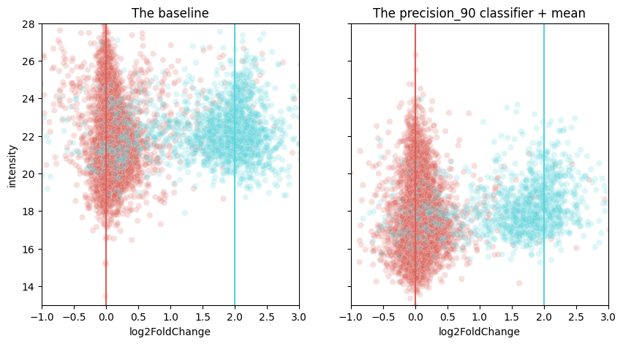
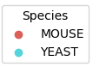
Yeast benchmark data

Slide 22
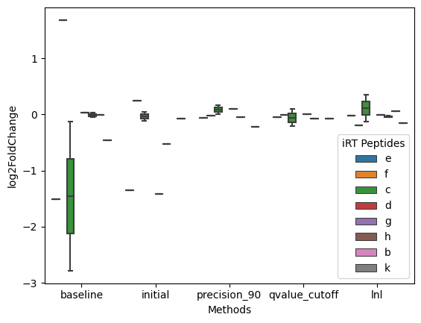
The differential expression of the iRT peptides
The average value of the difference between the actual and theoretical log2 fold change of 8 iRT peptides (‾x±sd)
 | Mean | Median | Top3 | Sum
initial | 0.54±0.603 | 0.55±0.304 | 0.23±0.111 | 0.49±0.469
precision_90 | 0.09±0.080 | 0.45±0.468 | 0.34±0.215 | 0.08±0.120
qvalue_cutoff | 0.07±0.071 | 0.35±0.355 | 0.31±0.443 | 0.14±0.203
lnl | 0.11±0.108 | 0.42±0.441 | 0.47±0.539 | 0.11±0.148
*baseline=0.74±1.008

Slide 23
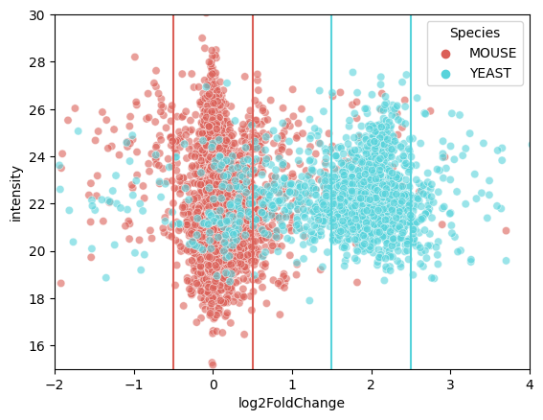
The accuracy of each method when given a ± 0.5 log2 fold change tolerance
The accuracy of the result within ±0.5 log2 fold change tolerance range (%)
 | Mean | Median | Top3 | Sum
initial | 93.95 | 94.26 | 96.38 | 94.22
precision_90 | 90.83 | 92.18 | 96.78 | 90.43
qvalue_cutoff | 92.79 | 93.73 | 96.85 | 91.84
lnl | 82.73 | 87.69 | 93.88 | 82.77
*baseline=75.09%
Aaverage of the optimized workflow: 91.95%
22.46% higher than the standard workflow(75.09%)

Slide 24
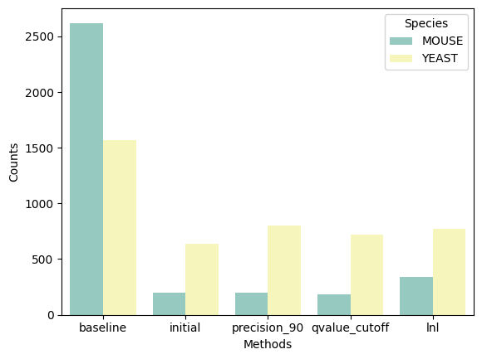
The number and species of protein deferentially expressed in the two groups
Mouse protein ratio within differentially expressed proteins (%)
 | Mean | Median | Top3 | Sum
initial | 36.66 | 36.78 | 23.62 | 36.17
precision_90 | 43.61 | 41.04 | 19.82 | 43.82
qvalue_cutoff | 39.08 | 36.57 | 20.22 | 41.22
lnl | 54.09 | 45.66 | 30.76 | 53.77
*baseline=62.56
Aaverage of the optimized workflow: 37.68%
39.77% lower than the standard workflow(62.56%)

Slide 25
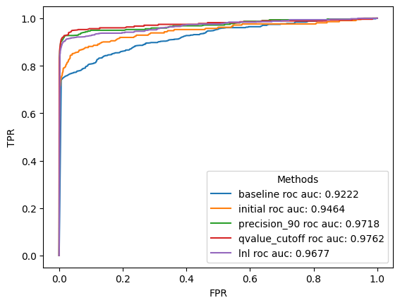
ROC curve and AUC
ROC-AUC = 0:
All mouse proteins are differentially expressed
ROC-AUC = 1:
All yeast proteins are differentially expressed

Slide 26
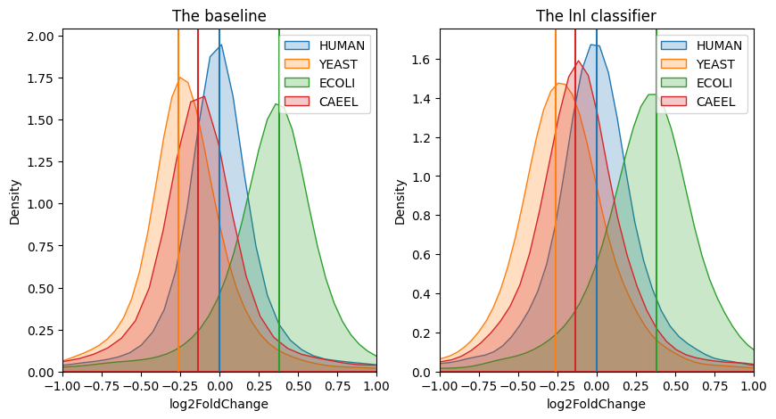
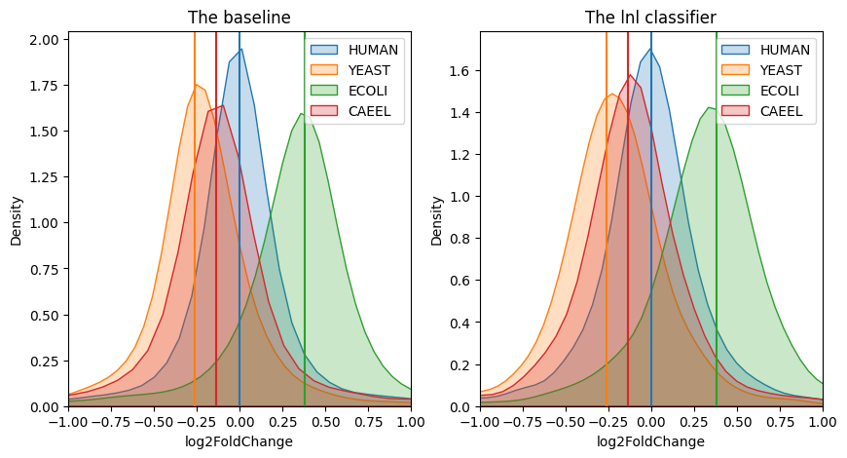
Multi-species proteomic data
Sample specific models
Yeast benchmark models

Slide 27

CONCLUSION

Slide 28
Conclusions
Using the FDR control algorithm we suggested in combination with machine learning to determine fragment ion ranking within a peak group, then combine them in an optimal way can provide more precise peptide quantification and significantly improve the accuracy of protein differential expression results
A model may have generalizability on unrelated diverse data sets

Slide 29
Acknowledgments
Lars Malmström
Aaron Scott
Johan Malmström
Christofer Karlsson
Carlos Alberto Gueto Tettay
Hong Yan
Di Tang
Anahita Bakochi
Joel Ströbaek
Erik Hartman
… and the others in D13

Slide 30


